Slide 1

Introduction to Basic Programming Concepts
University of Human Development College of Science and Technology Department of IT
Lecture :Programming
Lecturer: Tara Qadr
1st stage 2015-2016

Slide 2
Objectives
Know the edit, compile, and execute process.
Write a simple java program.
Show basic programming concepts
Identify the elements that make up a Java program
Use comments to improve the readability of your programs.

Slide 3
A Simple Java Program
Writing a program involves:
designing a strategy for solving the problem
using a programming language to implement that strategy.

Slide 4
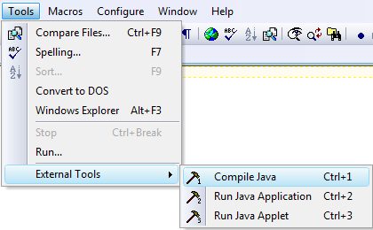
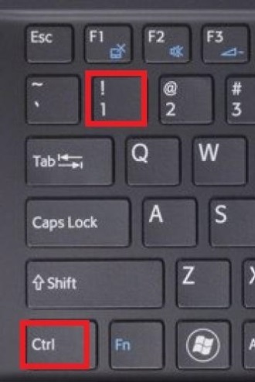
Simple Java Program
Create the program by typing it into TextPad, and save it the file as with extension .java.
Compile the program
Choosing: Tools
External tools
Compile java
Or Press Ctrl and 1key on the keyboard
This creates a Java bytecode file
with extension . class:

Slide 5
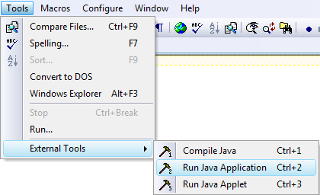
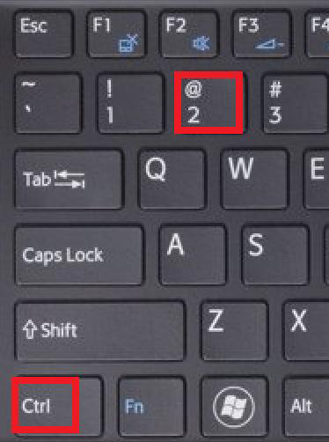
Execute the java program by:
Choosing: Tools
External Tools
Run Java Application
Or
Press Ctrl and 2 key on the keyboard

Slide 6
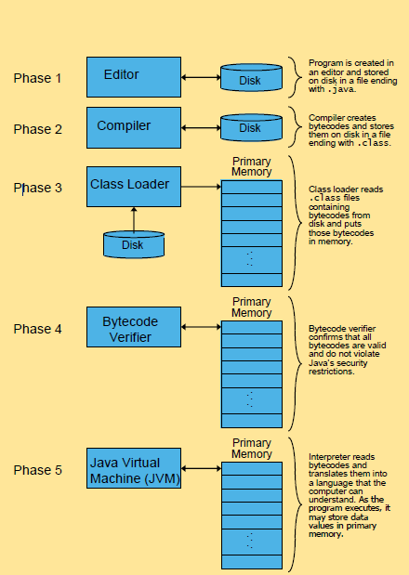
Steps in Creating,
Compiling and Executing
a Java Program

Slide 7
Anatomy of a Java Program
Comments
Reserved words
Modifiers
Classes
Methods
The main method
Statements
Blocks

Slide 8
Comments
Documentation for a single line:
// Everything until the end of the line is a comment
Multi-line documentation:
/* Every thing between these delimiters is a
comment */
The compiler ignores all text between the delimiters.

Slide 9
What Should You Document?
Program (or that portion of the program) author
What does the program do
e.g., tax program.
What are the specific features of the program
e.g., it calculates personal or small business tax.
What are it’s limitations
What is the version of the program

Slide 10
Reserved Words
Reserved words or keywords are words that have a specific meaning to the compiler and cannot be used for other purposes in the program.
For example, when the compiler sees the word class, it understands that the word after class is the name for the class.

Slide 11
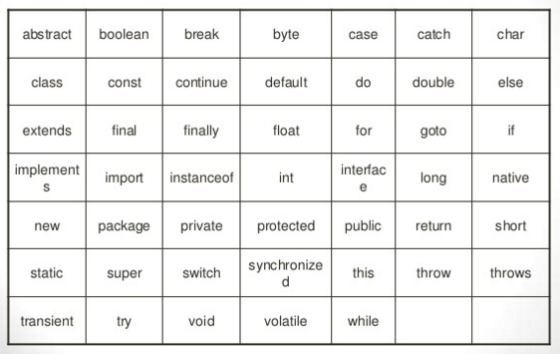
Java Keywords

Slide 12
Modifiers
Java uses certain reserved words called modifiers
Modifiers specify the properties of the data, methods, and classes and how they can be used.
Examples of modifiers are:
public and static.
private,
final,
abstract, and
protected.
A public members can be accessed by other programs.
A private member cannot be accessed by other programs.

Slide 13
Classes
The class is the essential Java construct.
A class is a template or blueprint for objects.
To program in Java, you must understand classes and be able to write and use them.
A program is defined by using one or more classes.

Slide 14
Methods
A method is a series of statements.
Each class may contain any number of methods.
In our simple example ”Firstlec.java” there is one method named main.
In general:
◦Method names begin with a lower letter
◦Java programs begin with the
method named main

Slide 15
Statements
A statement represents an action or a sequence of actions.
Each program may contain any number of statements.
System.out.println (“Hello, University, First Stage”)
is a statement.
Every statement in Java ends with a semicolon (;).

Slide 16
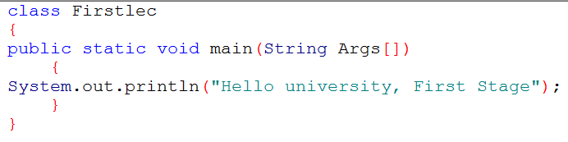
Blocks
A pair of braces in a program forms a block
Block groups components of a program.
In Java, each block begins with an opening brace ({) and ends with a closing brace (}).
Blocks can be nested, meaning that one block can be placed within another, as shown in the following code
Method Block
Class
Block

Slide 17
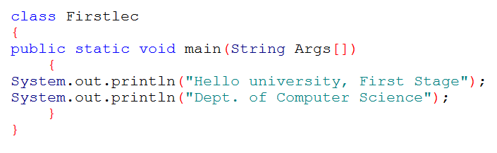
Displaying Multiple Lines of Text (1)
Modify the Firstlec.java program to display two line text, using two statements.

Slide 18
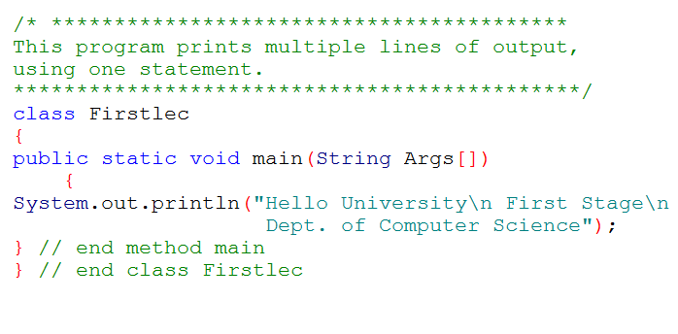
Displaying Multiple lines of Text (2)
Use a single statement output, to display multiple lines of text.

Slide 19
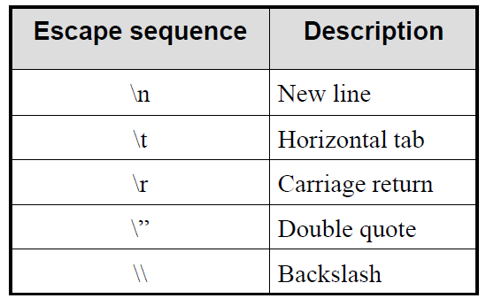
Some Escape Sequences For Formatting
Use escape sequences in println method
Example:
System.out.println(“Hello,\tUniversity!”);
System.out.println(“Dept. of \”Computer Science\” “);

Slide 20
Reference
INTRODUCTION TO JAVA PROGRAMMING COMPREHENSIVE VERSION 10th Edition
Paul Deitel , “Java How to Program”, 9thed.

Slide 21
THANK YOU

